Slide 1

Dr. Mahalingam College of Engineering & Technology
Department of Artificial Intelligence and Data Science 19ADPN6601 Innovative & Creative Project
Second Review
Title: MINI CNC PLOTTER USING OLD CD DRIVE
Batch Number : 07
Domain : ROBOTICS / DRONE / INDUSTRY 4.0
Team Members :
Vickram P (22BAD021)
Karthick Pranesh GSD (22BAD041)
Sujitha V (22BAD081)
Guide :
Ms. M. Rajalakshmi, AP/AD

Slide 2
Contents
Problem Statement
Objective
Literature Identified and Findings
Existing Block Diagram
Drawback
Proposed Block Diagram
List of Modules and detailed Module description
Results
Conclusion
Snapshots
Online Course/Contest / Publication Details
References

Slide 3
Problem Statement
How to improve the limited precision to achieve fine and accurate movements?
What modifications can extend the movement range with a limited travel distance from the CD drive?
How can real-time feedback and control ensure accurate and consistent drawing on a Mini CNC plotter?

Slide 4
Objective
To develop a low-cost mini CNC plotter using repurposed CD/DVD drive stepper motors, controlled by Arduino and G-code, for precise automated drawing and engraving. The project promotes e-waste recycling, supports open-source software, and serves as an educational tool for CNC and motion control learning.

Slide 5
Literature Identified and Findings

Slide 6
1. Low-cost CNC Plotter
“The design and development of a low-cost CNC plotter using stepper motors salvaged from CD/DVD drives.”
Findings :
Stepper motors can be effectively repurposed for CNC applications.
GRBL firmware is a reliable controller for precise movement.
The plotter is cost-efficient and easy to build, making it suitable for DIY
Limitations include a small working area and low torque output, restricting material compatibility.
Reference :A. Patel and R. Mehta, "Design and Implementation of a Low-Cost CNC Plotter," International Journal of Engineering Research, vol. 6, no. 4, pp. 220-225, 2022.

Slide 7
2. PCB engraving using Mini CNC Plotter
“An Arduino-based mini CNC machine specifically for PCB engraving.” Finding:
CD drive stepper motors can achieve high precision for PCB engraving.
Integration of GRBL firmware allows smooth G-code processing and execution.
The system reduces the cost of traditional PCB manufacturing.
Challenges include the inability to mill hard surfaces due to low motor torque.
Reference : S. Kumar and P. Rao, "Arduino-Based Mini CNC Machine for PCB Engraving," Journal of Embedded Systems, vol. 9, no. 3, pp. 145-152, 2021.

Slide 8
3. Automation of Drawing Mechanisms
“The Automation of Drawing Mechanisms to evaluates the Accuracy, Speed, and Practical Applications.”
Finding:
The plotter can replicate intricate designs with high precision.
Arduino-controlled stepper motors ensure smooth and precise motion control.
The system is useful for educational and artistic applications.
Limitation: Speed is relatively slower compared to commercial CNC machines.
Reference :J. Smith et al., "Automation of Drawing Mechanisms Using Repurposed CD Drives," IEEE Transactions on Mechatronics, vol. 5, pp. 98-105, 2020.

Slide 9
Literature Review Table
Year | Literature Identified | Algorithm Used | Merits | Demerits
2022 | Low-Cost CNC Plotter Using CD/DVD Drives | GRBL Firmware Control | Cost-efficient, DIY friendly, and precise movement | Small working area and low torque output
2021 | PCB Engraving Using Mini CNC Plotter | G-Code Processing with Arduino | High precision for PCB engraving and reduced PCB manufacturing costs | Unable to mill hard surfaces due to low motor torque
2022 | Automation of Drawing Mechanisms Using Repurposed CD Drives | Arduino-Controlled Stepper Motors | Ensures accurate designs with high precision, suitable for educational purposes | Slower speed compared to commercial CNC machines

Slide 10
Existing Block Diagram
Power Supply
Microcontroller
Motor Driver Modules
Z-Axis Mechanism
Y-Axis Stepper Motor
X-Axis Stepper Motor
Frame and Base Structure
Software Interface
Limit Switches

Slide 11
DRAWBACKS OF EXISTING SYSTEM
Mechanical Limitations
Small work area, weak structure, and limited load capacity.
Electrical & Control Issues
Weak stepper motors, low precision, and power constraints.
Software & Usability Challenges
Complex calibration, limited software support, and slow operation.
Overall Feasibility
Short lifespan, hard to upgrade, and not suitable for heavy-duty work.

Slide 12
Proposed Block Diagram
Power Supply Unit
Microcontroller
Motor Drivers
PC/Computer with G-Code Sender
Z-Axis Servo Motor
X-Axis & Y-Axis Stepper Motors

Slide 13
MODULE DESCRIPTION
Power Supply – Provides voltage for microcontroller and motors.
Microcontroller – Processes G-code commands (e.g., Arduino).
Motor Driver – Controls stepper motors (L293D, A4988).
Stepper Motors – X, Y, and Z-axis movement (CD drive motors).
Mechanical Frame – Repurposed CD/DVD drive structure.
Software Interface – G-code sender (UGS, Inkscape, Python).
Limit Switches – Prevents overtravel, helps calibration.
Z-Axis Mechanism – Controls pen up/down (servo motor).

Slide 14
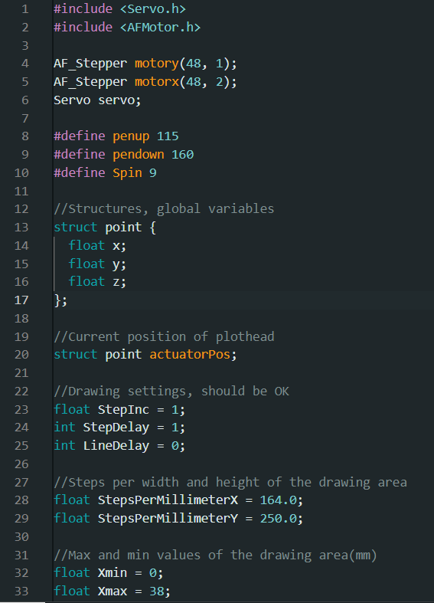
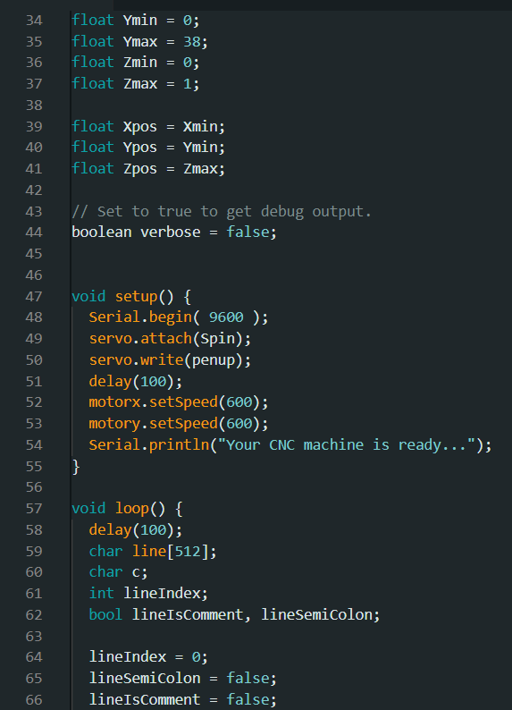
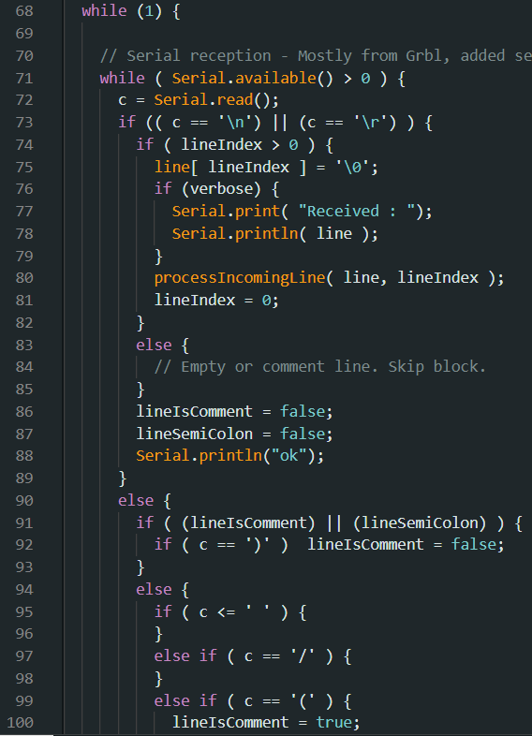
RESULT & DISCUSSION

Slide 15
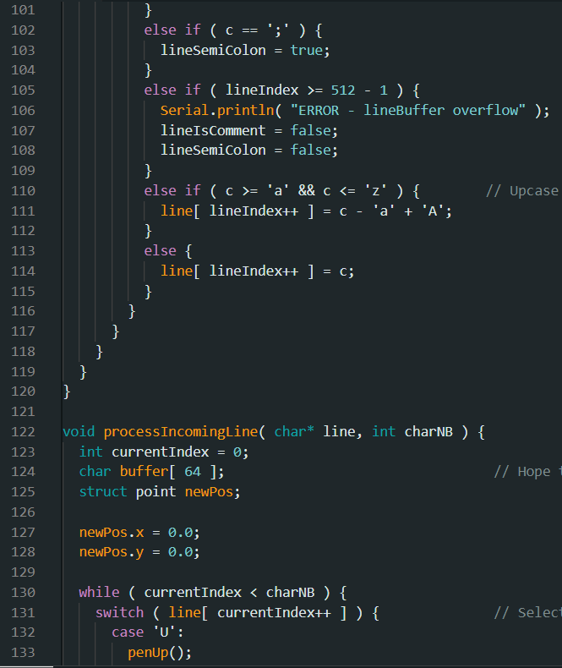
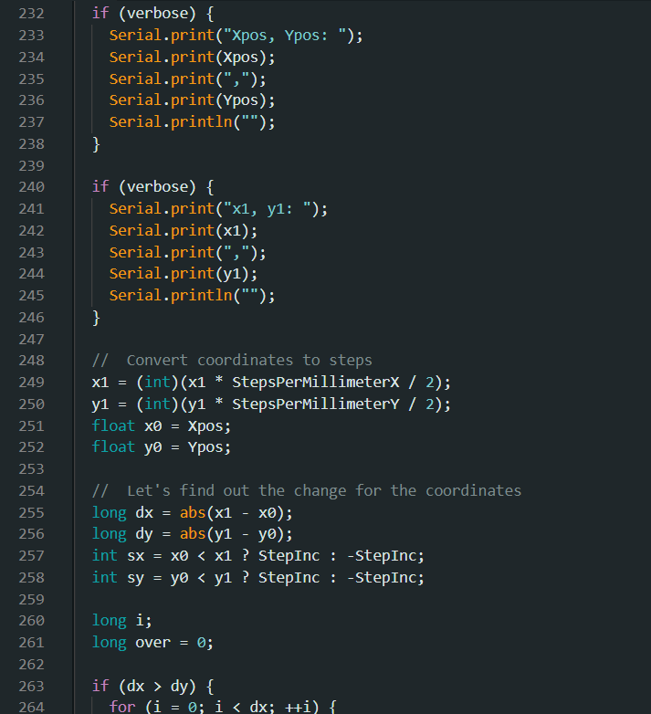
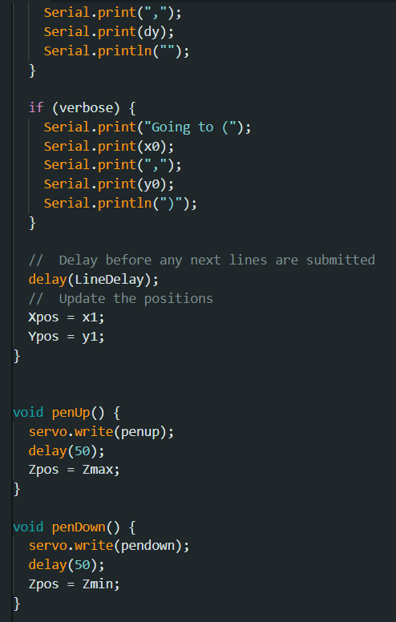
RESULT & DISCUSSION

Slide 16
RESULT & DISCUSSION
Precision & Accuracy: Achieves reasonable precision; minor deviations due to stepper motor resolution.
Speed & Efficiency: Moderate speed, limited by stepper motor step rate and microcontroller processing.
Interference & Stability: Minor vibrations and wear impact accuracy; software corrections help.
Energy Efficiency: Low power consumption, making it suitable for small-scale applications.
Limitations: Small workspace, limited torque, and not suitable for industrial precision.
Potential Improvements:
Enhanced motor drivers for better control.
Sturdier frame for improved stability.

Slide 17
CONCLUSION
Cost-effective & energy-efficient solution for DIY CNC plotting.
Repurposes old CD drive components for precise digital plotting.
Limited workspace & precision, but functional for small-scale applications.
Future improvements can enhance speed, accuracy, and stability.
A great proof-of-concept for low-cost CNC automation!

Slide 18
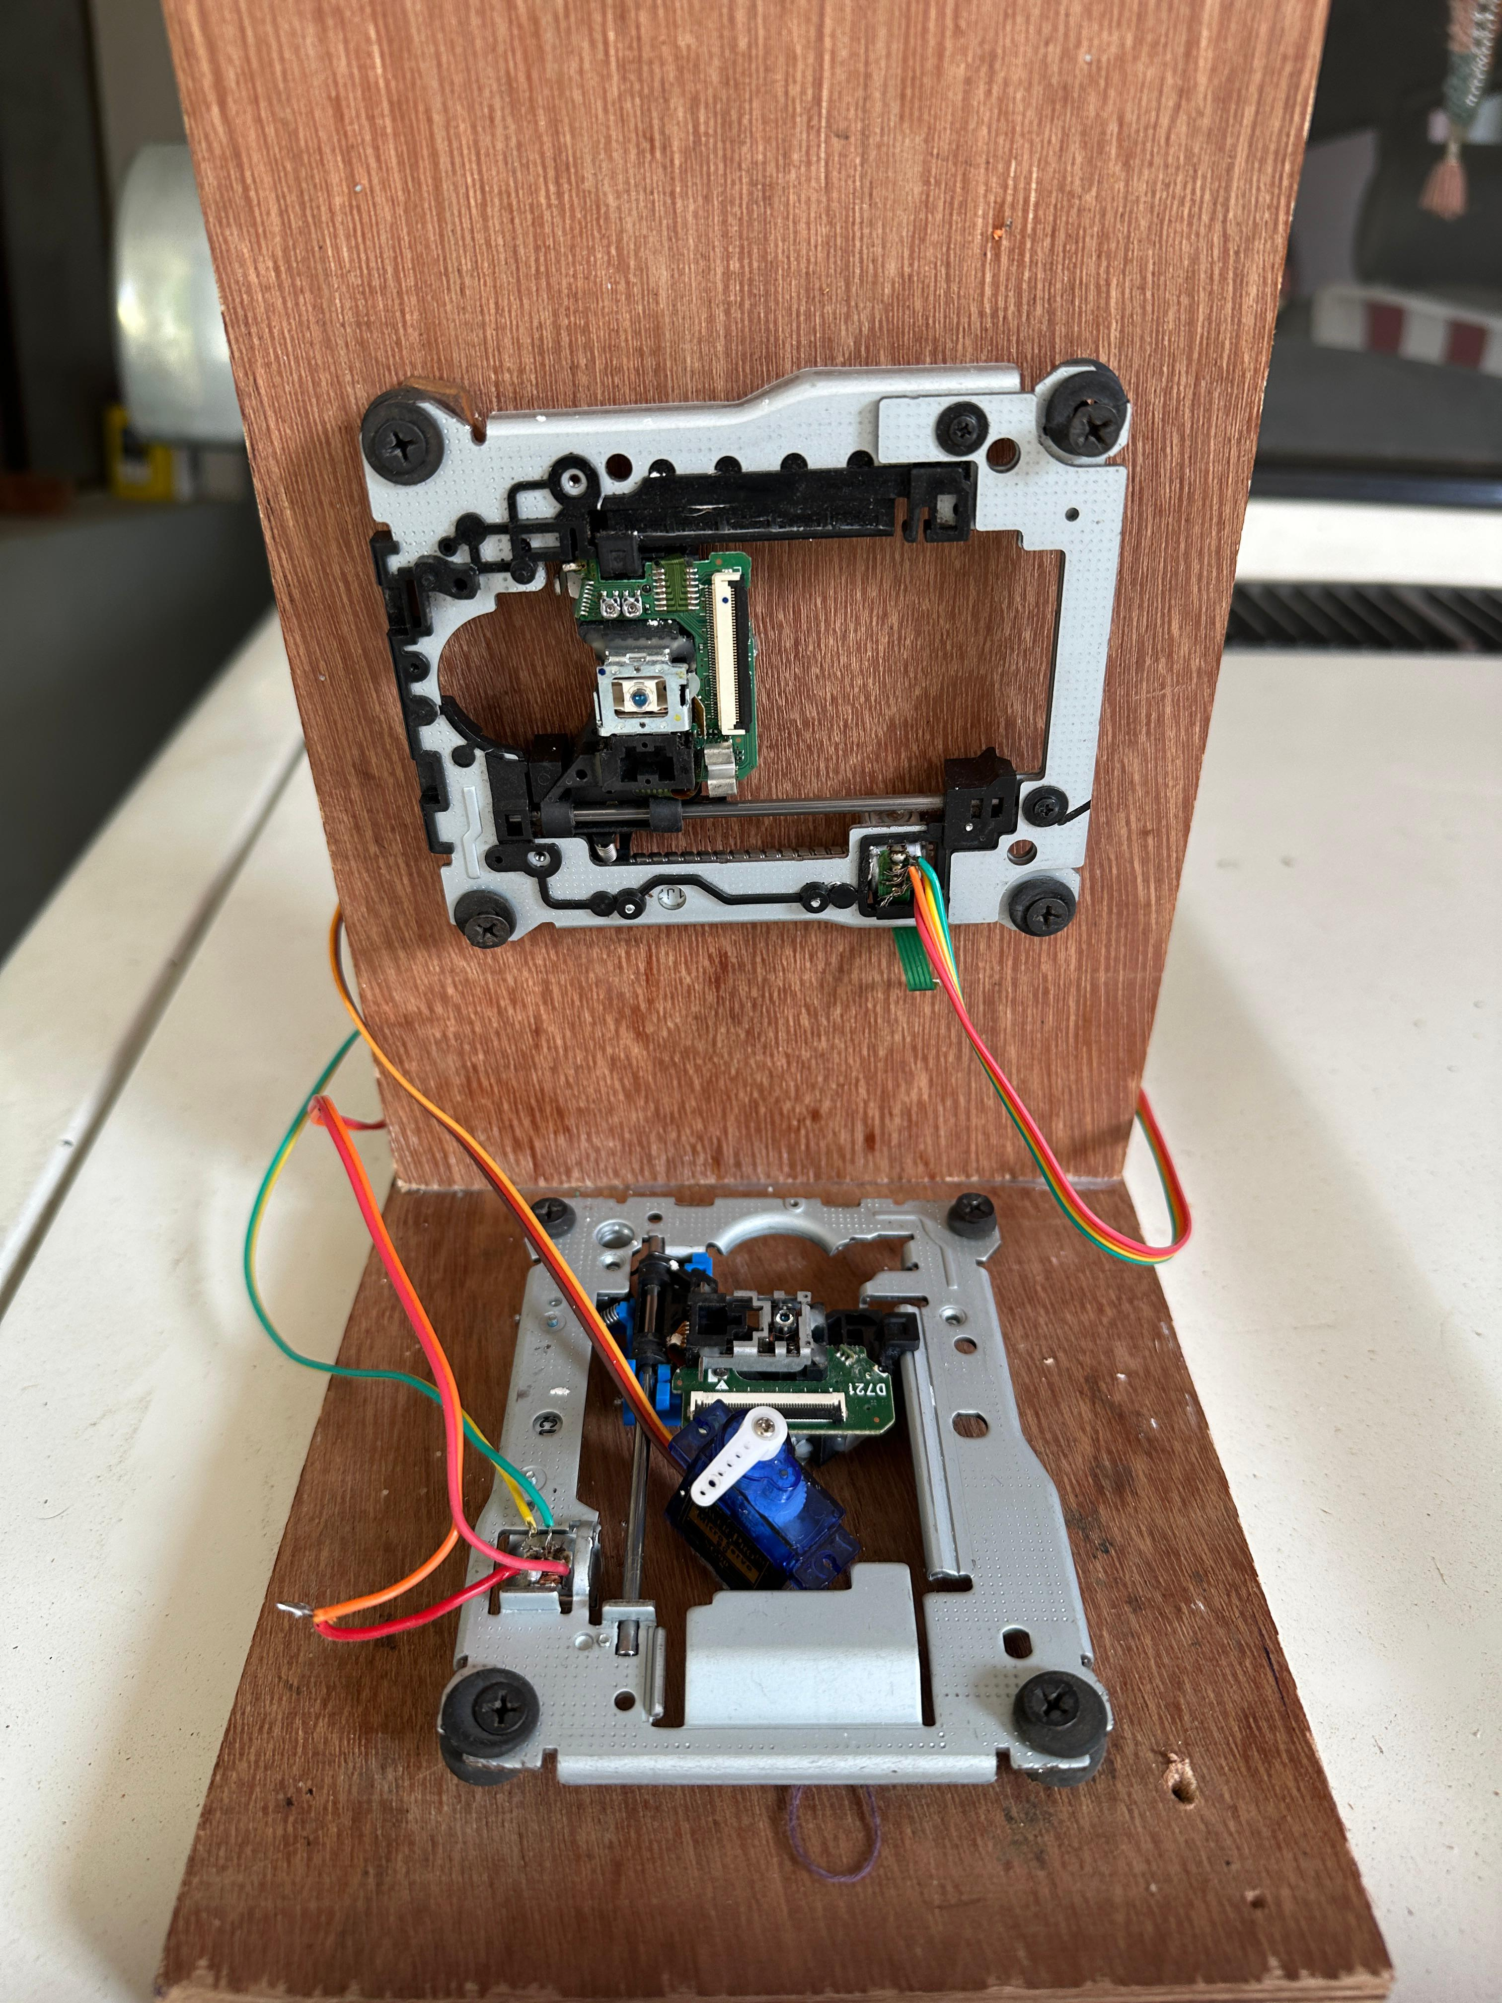
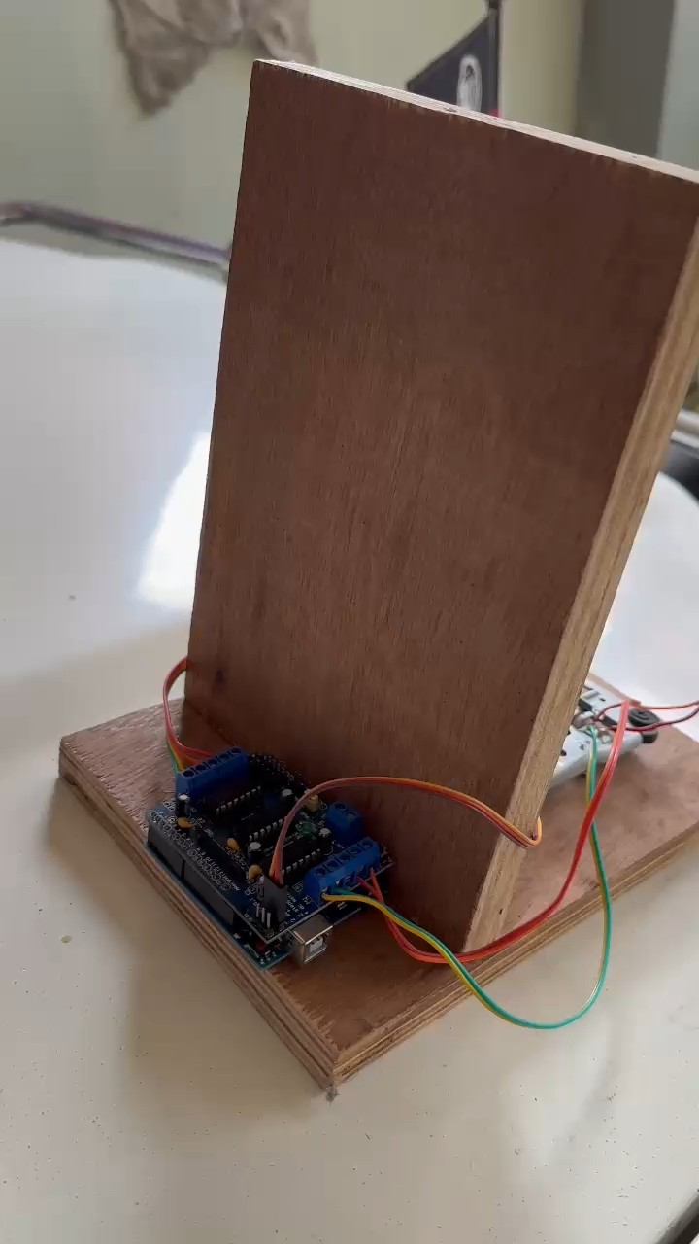
SNAPSHOTS

Slide 19
ONLINE COURSE DETAILS
NAME (ROLL NO) | COURSE NAME | PLATFORM | No. OF WEEKS | REMARKS/ STATUS
Karthick Pranesh GSD (727622BAD041) Sujitha V (727622BAD081) Vickram P (727622BAD021) | 3-D CAD Fundamental 3-D CAD Fundamental 3-D CAD Fundamental | Coursera Coursera Coursera | 3 weeks/approx 20 hours to complete 3 weeks/approx 20 hours to complete 3 weeks/approx 20 hours to complete | 16% Completed 20% Completed 10% Completed

Slide 20
References
[1] A. Patel and R. Mehta, "Design and Implementation of a Low-Cost CNC Plotter," International Journal of Engineering Research, vol. 6, no. 4, pp. 220-225, 2022.
[2] S. Kumar and P. Rao, "Arduino-Based Mini CNC Machine for PCB Engraving," Journal of Embedded Systems, vol. 9, no. 3, pp. 145-152, 2021.
[3] J. Smith et al., "Automation of Drawing Mechanisms Using Repurposed CD Drives," IEEE Transactions on Mechatronics, vol. 5, pp. 98-105, 2020.

Slide 21
THANK YOU

